Slide 1

Recitation Class (Midterm 2) — The Fourier Transform
Siqi YE
04/04/2018

Slide 2
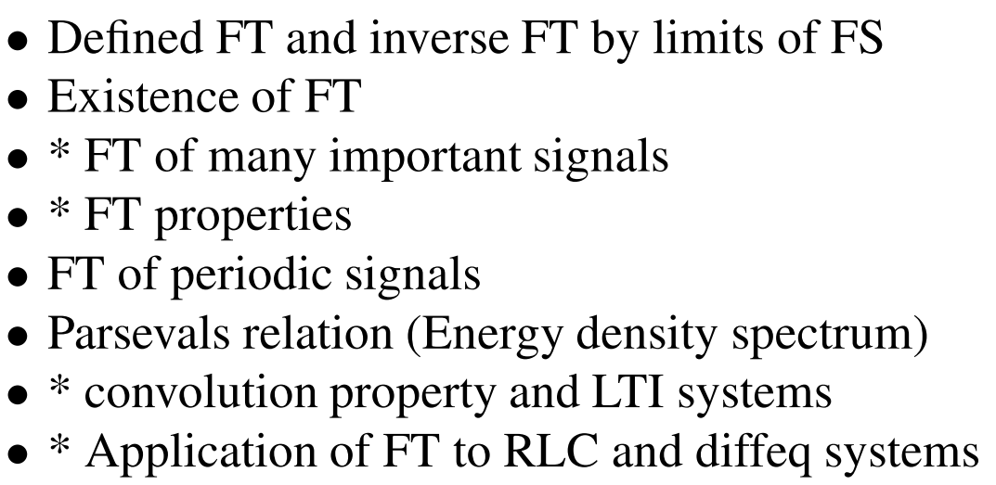
Outline
(Absolutely Integrable / Dirichlet conditions)

Slide 3
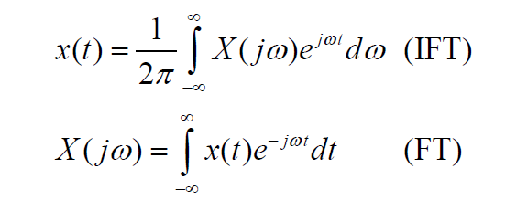

CONTENTS
Continuous-time, Nonperiodic Signals
Nonperiodic: $T_{0}→∞$

Slide 4
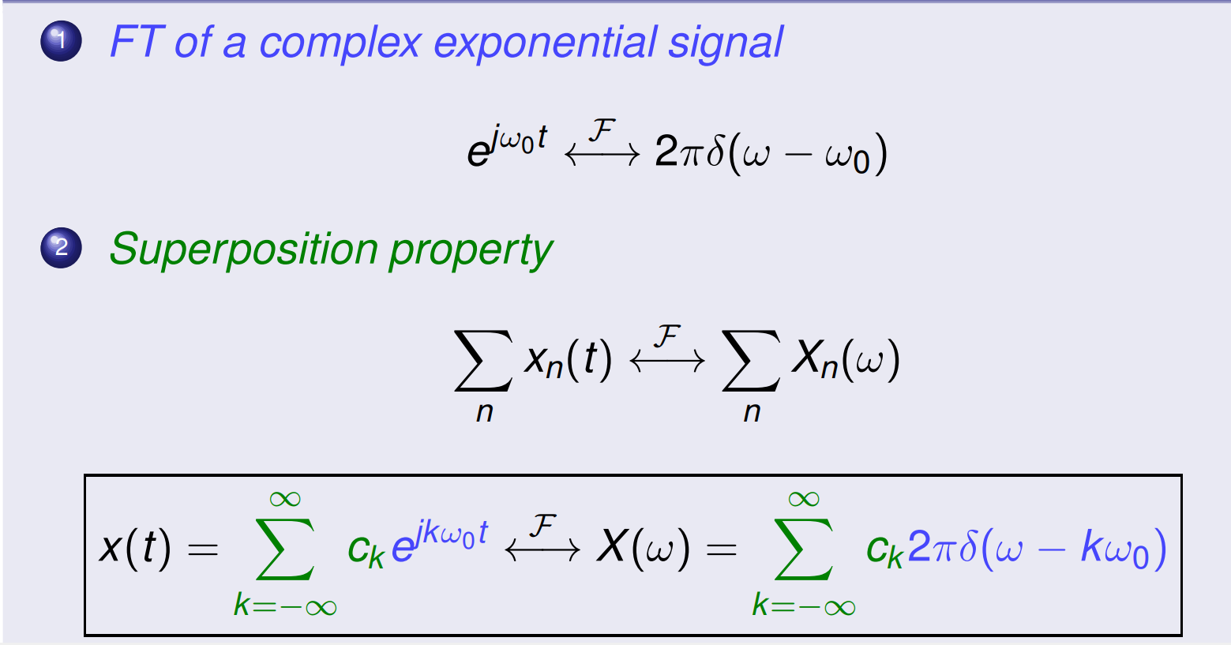
CONTENTS
FT of many important signals
Table of FT Pairs (Refer to summary 2)
Periodic signals:

Slide 5
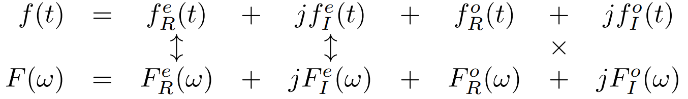
CONTENTS
FT Properties
Refer to summary 2
Convolution property
Symmetry properties

Slide 6
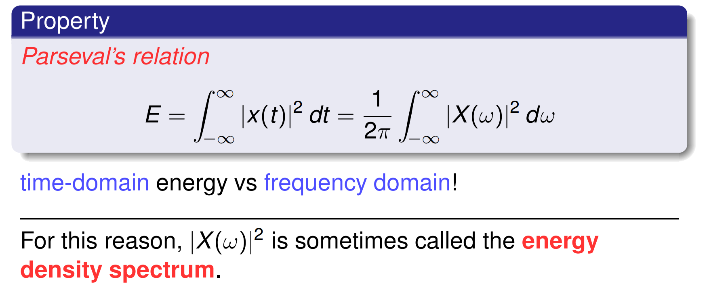
CONTENTS
Parseval’s relation

Slide 7
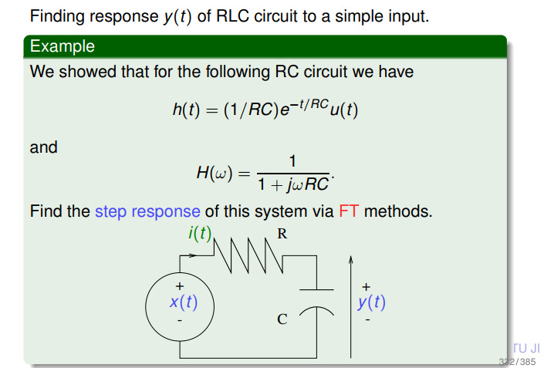
CONTENTS
Applications of FT to RLC and diffeq systems

Slide 8
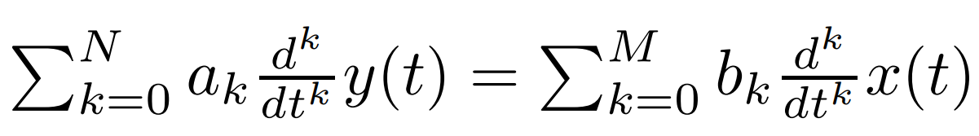
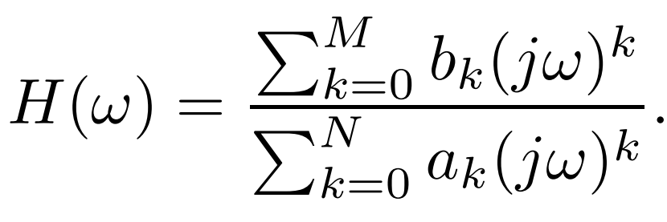
CONTENTS
Applications of FT to RLC and diffeq systems
Partial fraction expansion
Frequency response of diffeq system

